Slide 1
Substitution – Simple Interest
Miss Lum
Year 10 Maths

Slide 2

Learning Outcomes
Substitute values into formulas to determine an unknown (ACMNA234)
Context: Calculate Simple Interest

Slide 3

24
7
30
Simple Interest
Date: /03/2018
EQ – How do I calculate Simple Interest?
When you deposit money into a bank, the bank pays you interest.
When you borrow money from a bank, you pay interest to the bank.
Simple interest is money paid only on the principal.
Rate of interest is the percent charged or earned as a decimal
I = P $×$ r $×$ t
Time that the money is borrowed or invested (in years).
Principal is the amount of money borrowed or invested.

Slide 4
Gallery WALK
Divide by 100
& drop % sign
Change % to decimal
1) 12%
2) 5%
3) 2 ½ %
4) 8.5%
Change from decimal to %
5) .098
6) .455
Answers
1) 0.12
2) 0.05
3) 0.025
4) 0.085
Answers
5) 9.8%
6) 45.5%
Multiply by 100
& add % sign

Slide 5
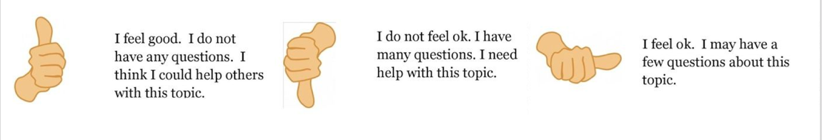
Check our understanding

Slide 6

24
7
30
Simple Interest
Date: /03/2018
EQ – How do I calculate Simple Interest?
Words Associated with Simple Interest
Per annum: It is Latin for per year. Per annum can also be written as p/a or p.a.
Investment: An amount of money put aside to earn money
Loan: Borrowing money from the bank and paying that amount of money back plus interest
Licensed under CC BY-NC-ND

Slide 7
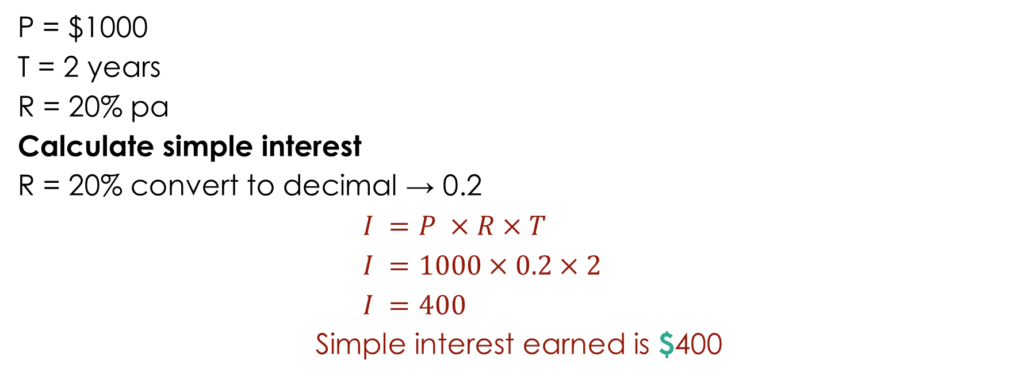
Let’s Try It Out
P = $1000
T = 2 years
R = 20% pa
Calculate simple interest
R = 20% convert to decimal → 0.2
$I =P ×R×T$
$I =1000×0.2×2$
$I =400$
Simple interest earned is $400
Now you try with a partner :
P = $1,500
T = 3 years
R= 15% p/a

Slide 8
One More To Be Sure
Ray has $750 in a savings account that pays 3% pa simple interest. How much interest will he earn in 4 years?

Slide 9
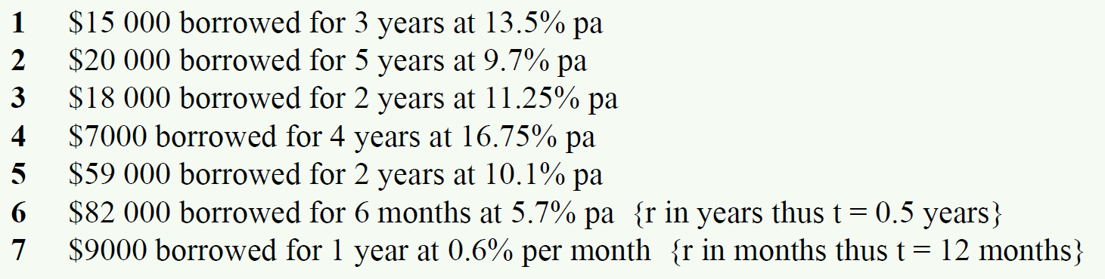
Calculate the Simple Interest

Slide 10
HomeWORK
Complete your summaries
Add new terms to your glossaries
Write your questions
24, 7, 30

